Slide 1
Bacterial vaginosis
By Prof Elna McIntosh
Clinical Sexologist
DISA Clinic Tel 011 787 1222 / 886 2286
www.safersex.co.za

Slide 2
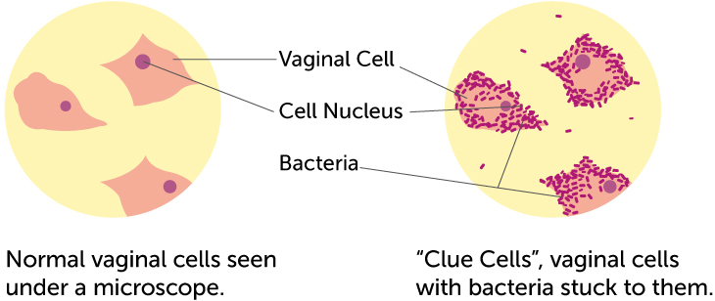
What is bacterial vaginosis?
Bacterial vaginosis (BV) is a condition that happens when there is too much of certain bacteria in the vagina. This changes the normal balance of bacteria in the vagina.

Slide 3
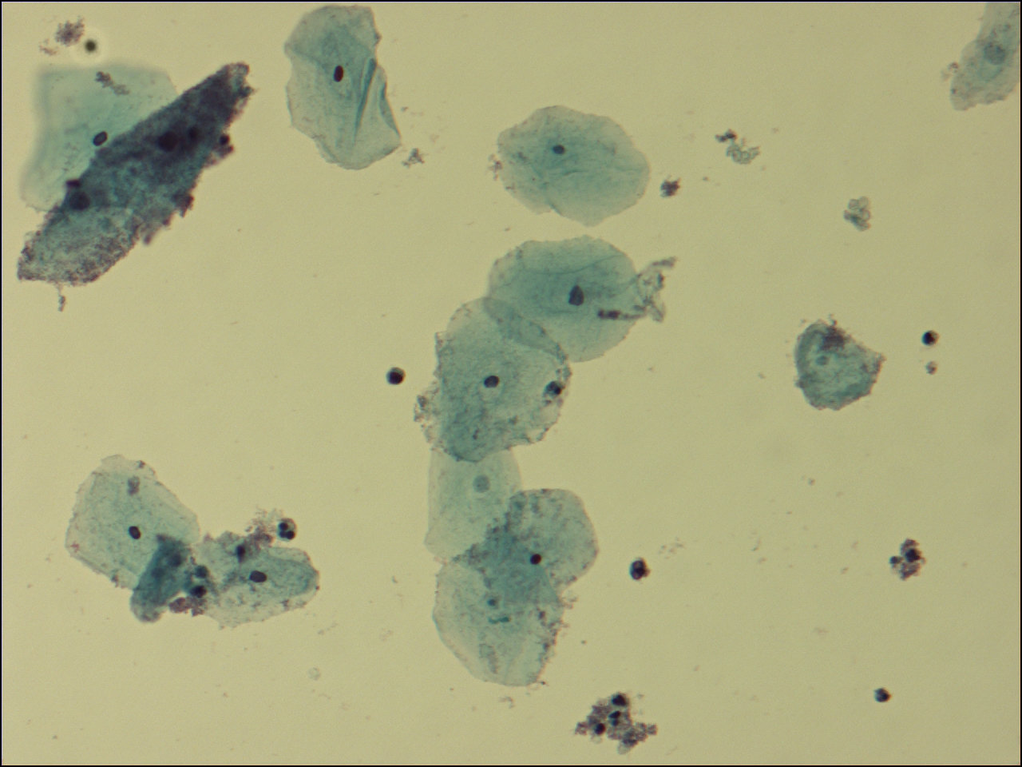
What is bacterial vaginosis? (Cont)
Bacterial vaginosis is an overgrowth of bacteria normally present in the vagina.
It's a polymicrobial condition, meaning there are many different bacteria involved and responsible.
In other words, it's a disturbance of the normal vaginal ecosystem.
Specifically, BV involves a high concentration of anaerobic bacteria.

Slide 4
How common is bacterial vaginosis?
Bacterial vaginosis is the most common vaginal condition in women ages 15-44.
BV has a moderate to severe impact on women
95% report a negative impact on their sex life.
Women report feeling self-conscious, embarrassed, and overall uncomfortable in social situations. They say they think that everyone can smell them. It really impacts their quality of life.

Slide 5
How is bacterial vaginosis spread?
Researchers do not know the cause of BV or how some women get it. We do know that the condition typically occurs in sexually active women. BV is linked to an imbalance of “good” and “harmful” bacteria that are normally found in a woman’s vagina. Having a new sex partner or multiple sex partners, as well as douching, can upset the balance of bacteria in the vagina. This places a woman at increased risk for getting BV.
We also do not know how sex contributes to BV. There is no research to show that treating a sex partner affects whether or not a woman gets BV. Having BV can increase your chances of getting other STDs.
BV rarely affects women who have never had sex.
You cannot get BV from toilet seats, bedding, or swimming pools.

Slide 6
How can I avoid getting bacterial vaginosis?
Doctors and scientists do not completely understand how BV spreads. There are no known best ways to prevent it.
The following basic prevention steps may help lower your risk of developing BV:
Not having sex;
Limiting your number of sex partners;
Not douching; and
Using latex condoms the right way every time you have sex.

Slide 7
How do I know if I have bacterial vaginosis?
Many women with BV do not have symptoms. If you do have symptoms, you may notice:
A thin white or grey vaginal discharge;
Pain, itching, or burning in the vagina;
A strong fish-like odour, especially after sex;
Burning when urinating;
Itching around the outside of the vagina.

Slide 8
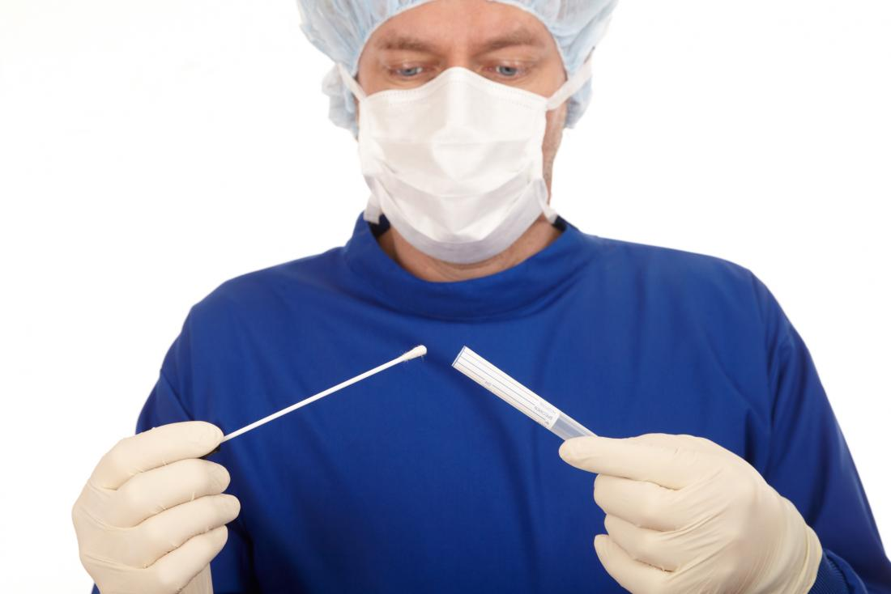
How will my doctor know if I have bacterial vaginosis?
A health care provider will examine your vagina for signs of vaginal discharge. Your provider can also perform laboratory tests on a sample of vaginal fluid to determine if BV is present.

Slide 9
Can bacterial vaginosis be cured?
BV will sometimes go away without treatment. But if you have symptoms of BV you should be checked and treated. It is important that you take all of the medicine prescribed to you, even if your symptoms go away. A health care provider can treat BV with antibiotics, but BV may return even after treatment. Treatment may also reduce the risk for some STIs.
Male sex partners of women diagnosed with BV generally do not need to be treated. BV may be transferred between female sex partners.

Slide 10
1st Line BV Treatment - from CDC guidelines
Metronidazole (Flagyl) 500 mg taken orally, twice a day x 7 days*
Metronidazole (Flagyl) gel 0.75%, 1 applicator (5 g) applied vaginally, once a day x 5 days*
Clindamycin (Cleocin) cream 2%, 1 applicator (5 g) applied vaginally, every night at bedtime x 7 days
*For metronidazole, it's important to avoid ALL alcoholic beverages until at least 72 hours after the last use. Consuming even a tiny amount of alcohol while on metronidazole will cause you to become very, very sick.

Slide 11
What happens if I don’t get treated?
BV can cause some serious health risks, including:
Increasing your chance of getting HIV if you have sex with someone who is infected with HIV;
If you are HIV positive, increasing your chance of passing HIV to your sex partner;
Making it more likely that you will deliver your baby too early if you have BV while pregnant;
Increasing your chance of getting other STIs, such as chlamydia and gonorrhoea. These bacteria can sometimes cause pelvic inflammatory disease (PID), which can make it difficult or impossible for you to have children.

Slide 12
Frequently asked Questions
Is there a relationship between BV and condom use, or between BV and semen? Every time my partner doesn't use a condom, my BV comes back.

Slide 13
Answer
The bacteria that cause BV are very sensitive to the vaginal pH. The normal vaginal pH is very acidic, and semen is very alkaline. When semen is ejaculated, it causes a pH shift in the vagina, which can cause BV to come back.

Slide 14
I’m pregnant. How does bacterial vaginosis affect my baby?
Pregnant women can get BV.
Pregnant women with BV are more likely to have babies born premature (early) or with low birth weight than pregnant women without BV. Low birth weight means having a baby that weighs less than 2 Kg at birth.
Treatment is especially important for pregnant women.

Slide 15
For more information contact us
Prof Elna McIntosh
Clinical Sexologist
DISA CLINIC
www.safersex.co.za
011 787 1222 / 011 886 2286

